Slide 1
Determining the Best Features of a House using a Linear Regression Model
By: Graham Haun

Slide 2
10 Random Predicts from the Model

Slide 3
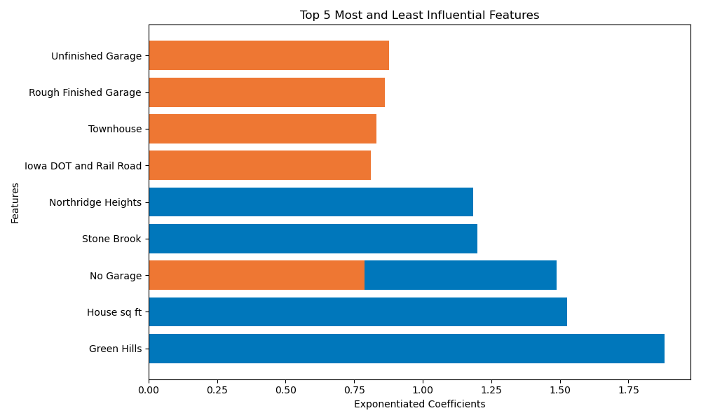
Best and Worst Features

Slide 4
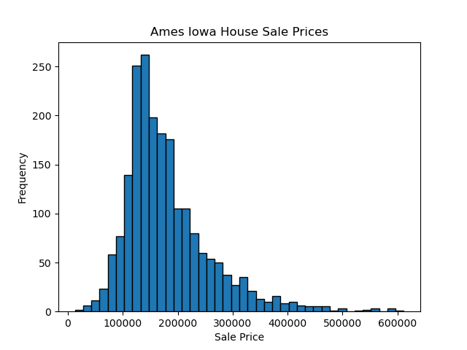
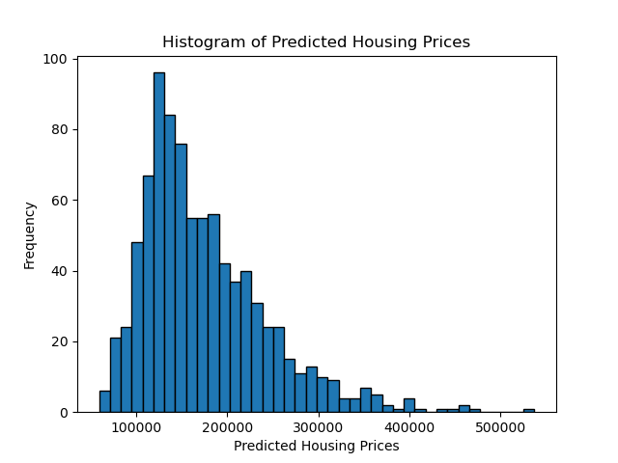
The Sale Price Comparisons
Mean: $176,373
Mean: $175,341

Slide 5
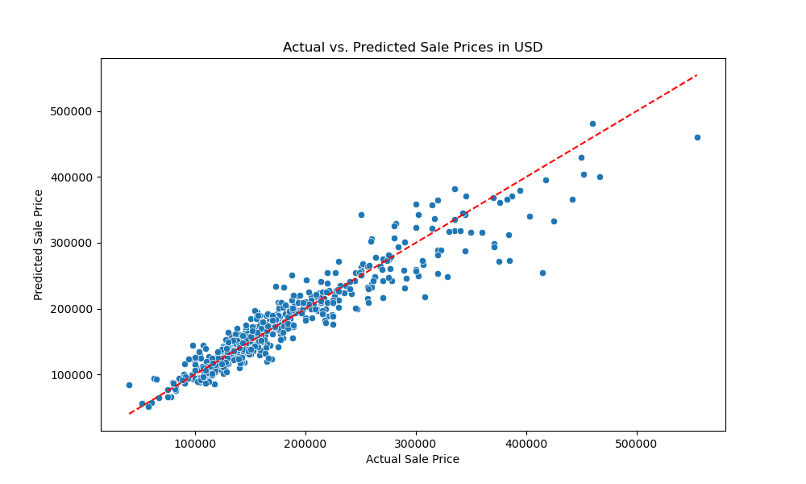
Actual vs Predicted Sales Price

Slide 6
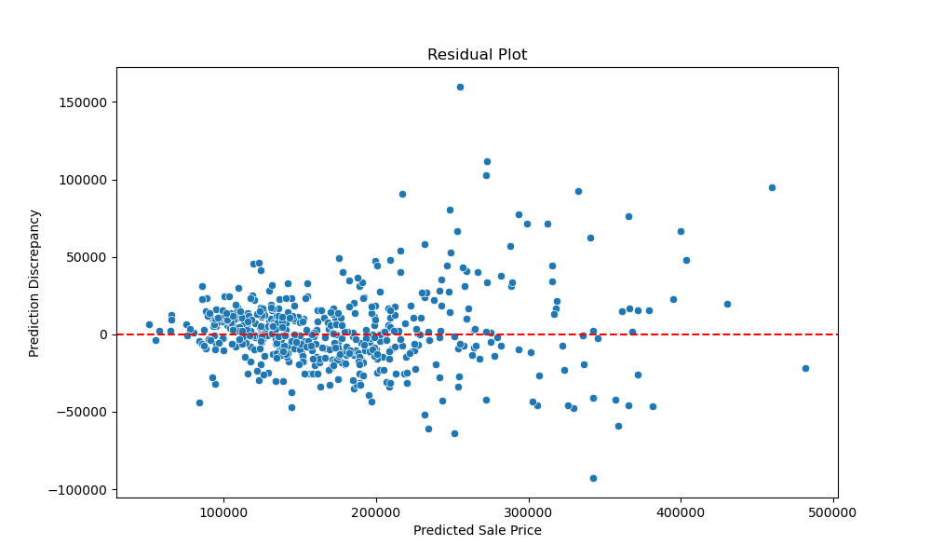
The Errors

